Slide 1
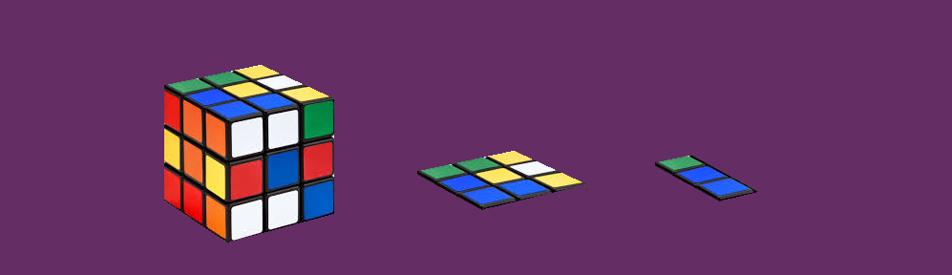
A look at state-of-the-art dimensionality reduction techniques

Slide 2

About Me
Bachelors in Mechanical Engineering from Jadavpur University
Masters in Operations Research from Indian Statistical Institute, Kolkata (current)
Summer and winter internships at Anheuser-Busch InBev (current)

Slide 3
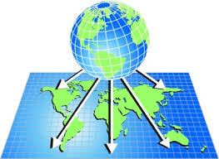
What is Dimensionality Reduction?
Dimensionality reduction is the ‘transformation’ of high-dimensional data into a ‘meaningful’ representation of reduced dimensionality.
Dimensionality reduction can never be perfect – there are always trade-offs

Slide 4

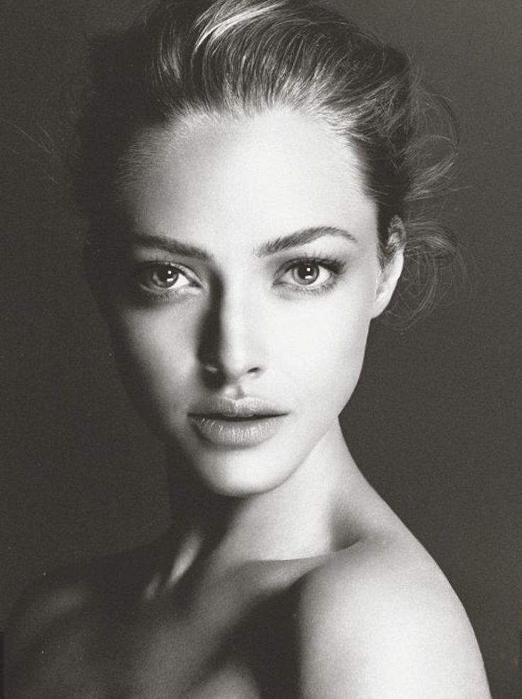
Why Dimensionality Reduction?
Face or not?
Why?
7090 pixels
5 interpretable features

Slide 5
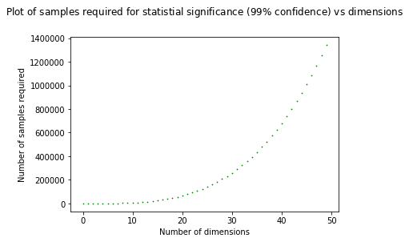
Why Dimensionality Reduction?
Number of samples required to arrive at statistically significant results increases exponentially with number of dimensions
Volume of search space increases faster than available sample size
Causes sparsity in data, leading to low confidence in predictions and inference

Slide 6














Mathematically
$$x_{2}$$
$$y_{2}$$
$$x_{1}$$
$$y_{3}$$
$$x_{3}$$
$$y_{1}$$
$$y_{4}$$
$$x_{4}$$
$$D>d$$
High Dimensional Data space $X$
Low Dimensional Map space $Y$
$D$ dimensions
$d$ dimensions

Slide 7
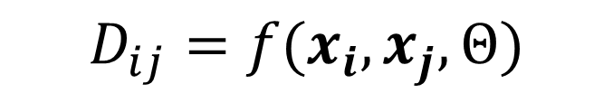
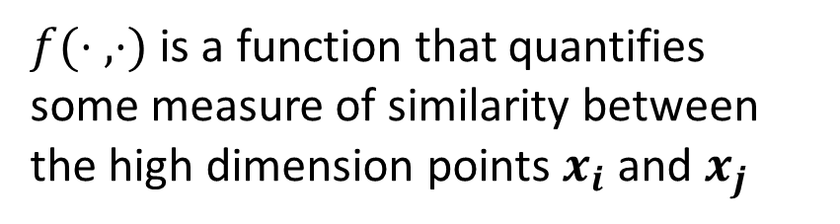

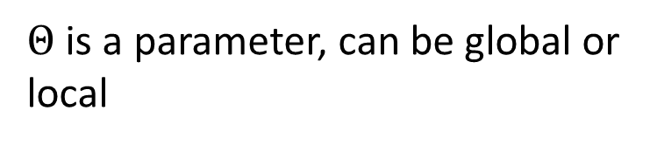
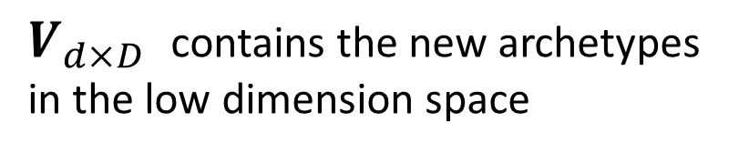
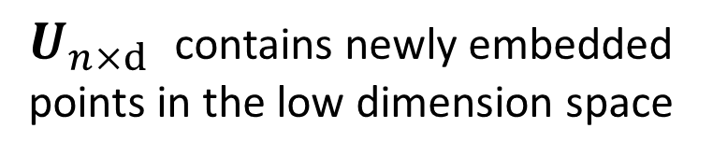
Broad Approaches
Matrix Factorization
Manifold Learning
$$X_{n×D}≈U_{n×d}V_{d×D}$$
$$D_{ij}=f(x_{i}, x_{j}, Θ)$$
$U_{n×d}$ contains newly embedded points in the low dimension space
$Θ$ is a parameter, can be global or local
$V_{d×D}$ contains the new archetypes in the low dimension space
$f(⋅ ,⋅)$ is a function that quantifies some measure of similarity between the high dimension points $x_{i}$ and $x_{j}$

Slide 8
Pros and Cons of Factorization Methods
Pros
Simple, in form and function
Cost function is always convex, or can be converted to its convex form, so we are guaranteed a global optima everytime
Computationally fast, as only linear matrix operations need to be done
Cons
Cannot model non-linear interactions between variables
Cannot map datapoints in manifolds, even less so if they are non-linear
Very sensitive to outliers as most minimize sum of squared errors
New variables are always linear combinations of input variables, so complex intrinsic features cannot be extracted

Slide 9
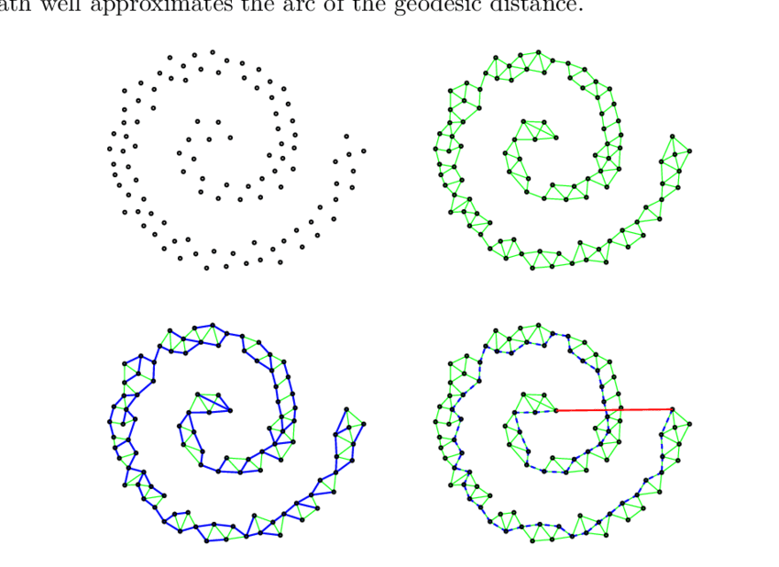
Manifold Learning
Manifold to weighted graph
Non-linear patterns cannot be identified through matrix factorization
To uncover non-linearity, local structure needs to be identified
Modelling manifolds is difficult, presence of noise and absence of uniformly spaced data have adverse impact
Adequately weighted graphs subject to certain constraints can help with representation of this non-linearity
Graphs can be converted into matrices, which are somewhat familiar territory
Weighted graph to matrix

Slide 10


Manifold Learning : Unified Approach
The first step involves calculation of some similarity/dissimilarity matrix between all pairs of points in the dataset
The second step involves calculating analogous similarity matrix between all pairs of points in the lower dimension embedding
$$D=$$
$$d=$$

Slide 11

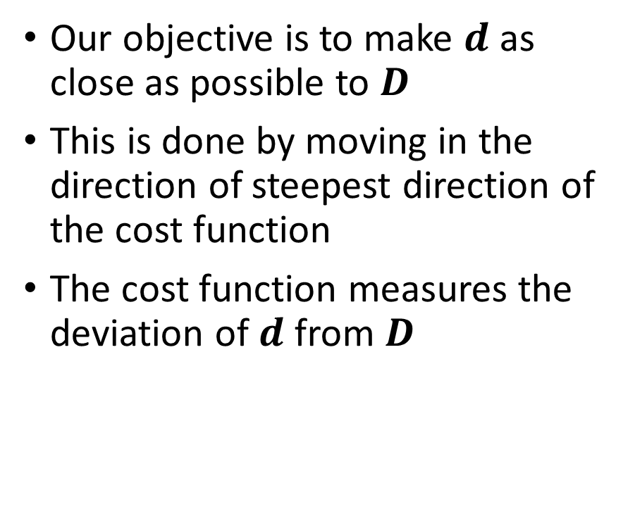
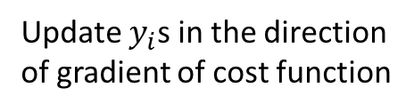
Manifold Learning : Minimizing Differences
Our objective is to make $d$ as close as possible to $D$
This is done by moving in the direction of steepest direction of the cost function
The cost function measures the deviation of $d$ from $D$
Calculate cost function
Repeat until convergence
Update $y_{i}$s in the direction of gradient of cost function

Slide 12

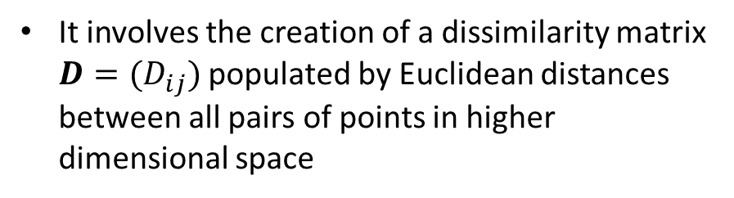

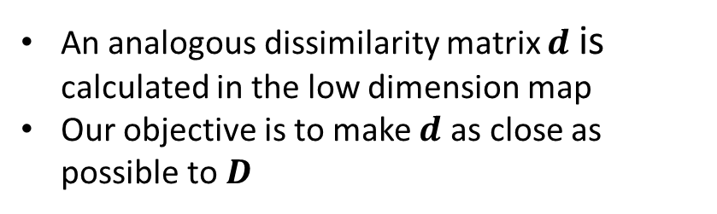
Multi-Dimensional Scaling
It involves the creation of a dissimilarity matrix $D=(D_{ij})$ populated by Euclidean distances between all pairs of points in higher dimensional space
An analogous dissimilarity matrix $d$ is calculated in the low dimension map
Our objective is to make $d$ as close as possible to $D$
3
4
1
2
1
2
3
4
 | 1 | 2 | 3 | 4
1 | 0 | 1.5 | 1.4 | 3.4
2 | 1.5 | 0 | 0.9 | 1.7
3 | 1.4 | 0.9 | 0 | 1.8
4 | 3.4 | 1.7 | 1.8 | 0
 | 1 | 2 | 3 | 4
1 | 0 | 0.9 | 2.2 | 3
2 | 0.9 | 0 | 1.6 | 1.7
3 | 2.2 | 1.6 | 0 | 1.8
4 | 3 | 1.7 | 1.8 | 0
Moving onto lower dimension
$$D=$$
$$d=$$

Slide 13

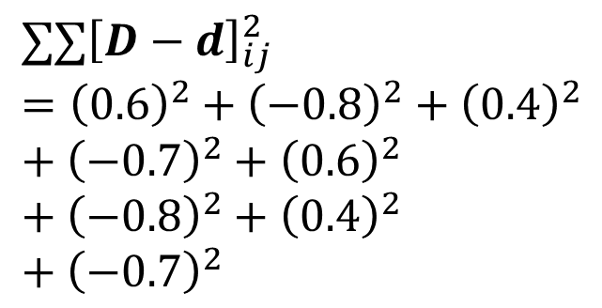
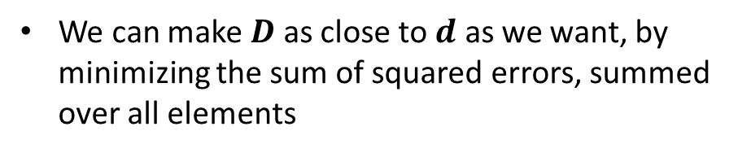


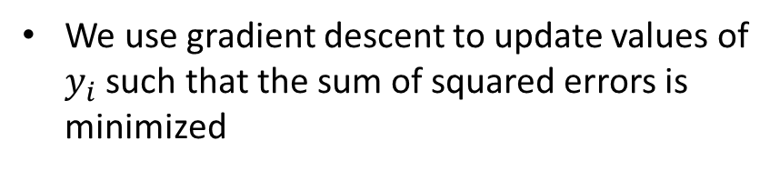
Multi-Dimensional Scaling
We can make $D$ as close to $d$ as we want, by minimizing the sum of squared errors, summed over all elements
We use gradient descent to update values of $y_{i}$ such that the sum of squared errors is minimized
 | 1 | 2 | 3 | 4
1 | 0 | 1.5 | 1.4 | 3.4
2 | 1.5 | 0 | 0.9 | 1.7
3 | 1.4 | 0.9 | 0 | 1.8
4 | 3.4 | 1.7 | 1.8 | 0
$$D=$$
 | 1 | 2 | 3 | 4
1 | 0 | 0.6 | -0.8 | 0.4
2 | 0.6 | 0 | -0.7 | 0
3 | -0.8 | -0.7 | 0 | 0
4 | 0.4 | 0 | 0 | 0
$$∑∑{\left[D−d\right]}_{ij}^{2}={\left(0.6\right)}^{2}+{\left(−0.8\right)}^{2}+{\left(0.4\right)}^{2}+{\left(−0.7\right)}^{2}+{\left(0.6\right)}^{2}+{\left(−0.8\right)}^{2}+{\left(0.4\right)}^{2}+{\left(−0.7\right)}^{2}$$
 | 1 | 2 | 3 | 4
1 | 0 | 0.9 | 2.2 | 3
2 | 0.9 | 0 | 1.6 | 1.7
3 | 2.2 | 1.6 | 0 | 1.8
4 | 3 | 1.7 | 1.8 | 0
$$D−d=$$
$$d=$$

Slide 14
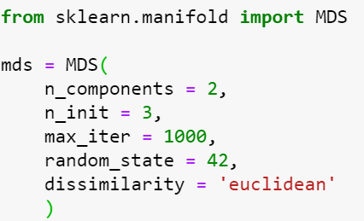
MDS : Parameters
Number of Components: The dimension of the lower-dimension map-space
Number of Initializations: Number of times the algorithm will be run. The best output is chosen for the final result
Maximum number of iterations: Maximum number of iterations for the algorithm in a single run
Random State: The number used as seed to initialize the low dimension embeddings
Dissimilarity: Specifies the dissimilarity metric, usually Euclidean but can be custom-defined

Slide 15
Drawbacks of MDS
Fails when data-points are distributed non-uniformly across the manifold
Highly sensitive to outliers as it minimizes the sum of squared errors
Considers Euclidean distances, hence misses out on very high intrinsic dimensionality
Holes and disconnected manifolds get collapsed and are not modelled accurately

Slide 16
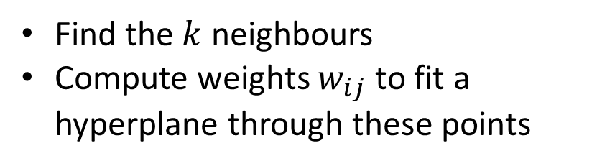






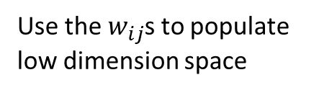
Locally Linear Embedding
Find the $k$ neighbours
Compute weights $w_{ij}$ to fit a hyperplane through these points
Reconstruct the low dimension space using the same weights on the same entities
Update locations by gradient descent on error
Repeat until convergence criteria reached
$$w_{i1}$$
$$w_{i3}$$
Use the $w_{ij}$s to populate low dimension space
$$w_{i1}$$
$$w_{i3}$$
$$w_{i2}$$
$$w_{i2}$$
High-dimensional space
Low-dimensional space

Slide 17
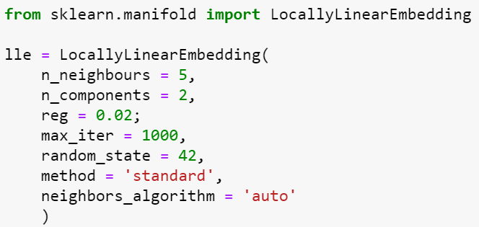
LLE : Parameters
Number of Neighbours: The number of neighbours to consider for fitting a hyperplane
Number of Components: The dimension of the lower-dimension map-space
Regularization Constant: Scales spacing between clusters
Maximum number of iterations: Maximum number of iterations for the algorithm in a single run
Random State: The number used as seed to initialize the low dimension embeddings
Method: Either ‘normal’, or ‘hessian’, or ‘ltsa’ or ‘modified’
Neighbors Algorithm: Usually ’auto’ is the best

Slide 18
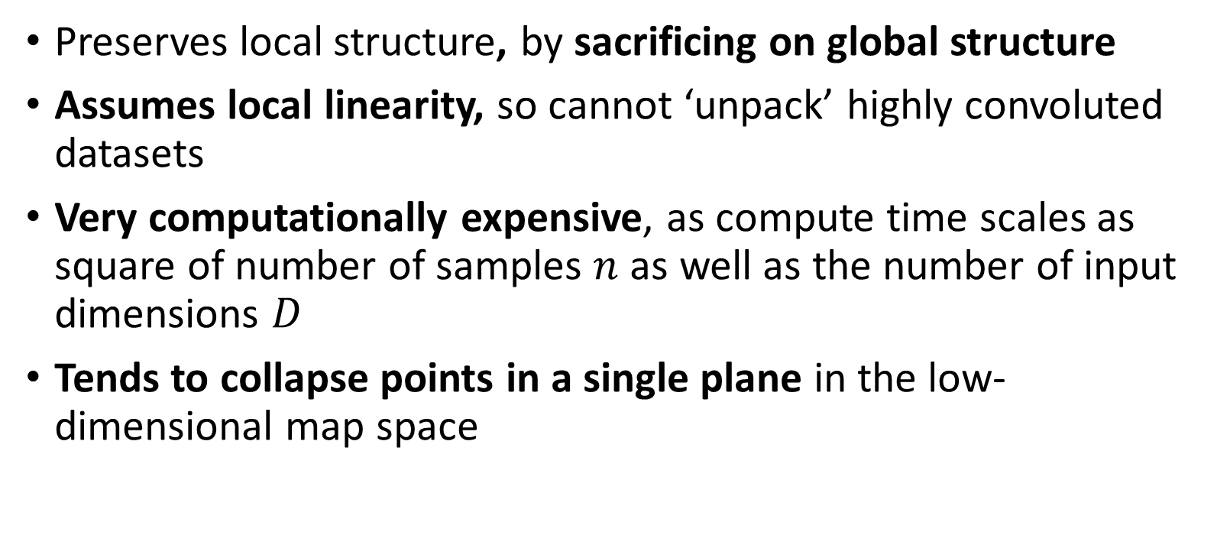
Drawbacks of LLE
Preserves local structure, by sacrificing on global structure
Assumes local linearity, so cannot ‘unpack’ highly convoluted datasets
Very computationally expensive, as compute time scales as square of number of samples $n$ as well as the number of input dimensions $D$
Tends to collapse points in a single plane in the low-dimensional map space

Slide 19
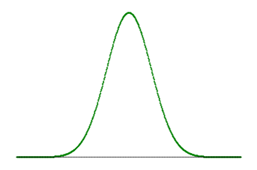







t- Distributed Stochastic Neighborhood Embedding
We convert Euclidean distances between high-dimensional data-points to probabilities using a Gaussian distribution
$$D_{i1}$$
$$D_{i2}$$
$$p_{i1}$$
$$p_{i2}$$
$$D_{i1}$$
$$D_{i2}$$
$$p_{i1}=0.7$$
$$p_{i2}=0.2$$

Slide 20







t-SNE
Similarly, we convert distances to probabilities in the lower dimension map, using a t-distribution
$$d_{i1}$$
$$d_{i2}$$
$$q_{i1}$$
$$q_{i2}$$
$$d_{i1}$$
$$d_{i2}$$
$$q_{i1}=0.3$$
$$q_{i2}=0.7$$

Slide 21
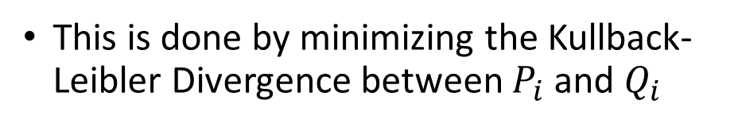
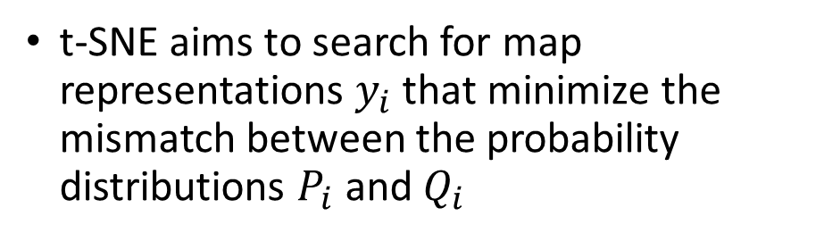
t-SNE
t-SNE aims to search for map representations $y_{i}$ that minimize the mismatch between the probability distributions $P_{i}$ and $Q_{i}$
This is done by minimizing the Kullback-Leibler Divergence between $P_{i}$ and $Q_{i}$
Minimizing KL Divergence pushes similar points towards each other, and dissimilar points away from each other
and so on…

Slide 22
t-SNE
t-SNE aims to capture local structure of data, and excels at modelling non-linear neighbourhoods
It ensures similar points in high-dimensional space are placed close together in their low-dimensional representation
However, it doesn’t ensure faraway points in high-dimensional space will be placed equally far away in low-dimensions
and so on…

Slide 23
t-SNE
The final low-dimension embedding when stability is achieved is shown
Distance between clusters indicate dissimilarity, but not to what extent
Density of clusters in low dimension is not indicative of cluster density in high-dimensions
Cluster density is arbitrary
Inter-cluster distance is misleading

Slide 24
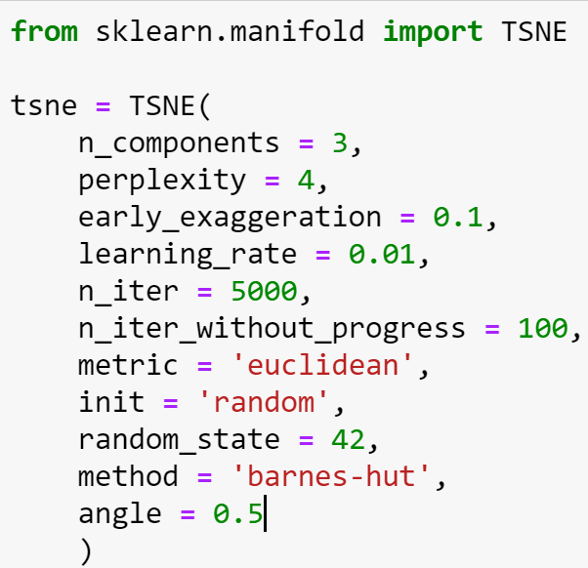
t-SNE : Hyperparameters
Number of Components: The dimension of the lower-dimension map-space
Perplexity: Number of neighbours to be considered. Values between 5-50 give best results
Early Exaggeration: How close the natural clusters in original space will be in the embedded space.
Gradient Descent Tuning: learning rate, n_iter, n_iter_without_progress
Metric: Choosing distance metric
Initialization: The initialization of the embedding, can be random, PCA, SVD etc
Random State: Essentially conveys the stochastic nature of t-SNE
Angle: Controls the accuracy-vs-speed trade-off. Values between 0.2-0.7 work best

Slide 25
Drawbacks of t-SNE
No incremental learning since non-parametric. The entire optimization has to be carried out again
Fails in datasets with high intrinsic dimensionality because of the local linearity assumptions arising out of Euclidean distances while computing probabilities
Non-convex cost function adds to the complexity, so suitable hyperparameters need to be selected to avoid ending up in a poor local minima

Slide 26
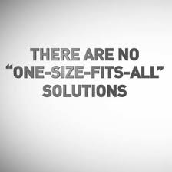
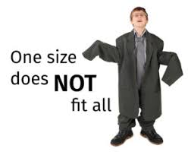
Choosing the best method
No universal metric exists for comparing the qualities of various dimensionality reduction methods, therefore no best method of dimensionality reduction
This is because it is hard to quantify information loss that occurs in dimensionality reduction by one single metric
Different methods optimize different error functions, so using a single metric to quantify information loss is misleading

Slide 27
Further Reading
“A global geometric framework for nonlinear dimensionality reduction“ Tenenbaum, J.B.; De Silva, V.; & Langford, J.C. Science 290 (5500)
“Nonlinear dimensionality reduction by locally linear embedding” Roweis, S. & Saul, L. Science 290:2323 (2000)
“Modern Multidimensional Scaling - Theory and Applications” Borg, I.; Groenen P. Springer Series in Statistics (1997)
“Visualizing High-Dimensional Data Using t-SNE” van der Maaten, L.J.P.; Hinton, G. Journal of Machine Learning Research (2008)
“t-Distributed Stochastic Neighbour Embedding” van der Maaten, L.J.P. (2012)
https://distill.pub/2016/misread-tsne/ : Blog on how to use t-SNE effectively

Slide 28




Questions?
Contact me via:
maiti.tamojit@gmail.com
https://bit.ly/2u4QPHt
https://github.com/tamojit-maiti
Codes available on Github

